Slide 1




Early detection of patient deterioration at home
using smart medical sensors
Bachelor Thesis Proposal
Julian Lobbes

Slide 2
Agenda
Background
Motivation
Objectives
Tasks
Julian Lobbes

Slide 3
Background: Deterioration
Adverse clinical events are preceeded by a decline in vital functions
  Clinical deterioration
Observable in advance
Julian Lobbes

Slide 4
Background: Early warning scores
Early Warning Scores (EWS)
  indicator for:
    decline in overall vital functions
    severity of illness
  predictor for:
    length of hospital stay
    ICU admission
    mortality
Julian Lobbes

Slide 5
Background: Early warning scores
Widely used internationally
In hospitals and ambulant care
For triage, monitoring, care escalation and communication
Julian Lobbes

Slide 6
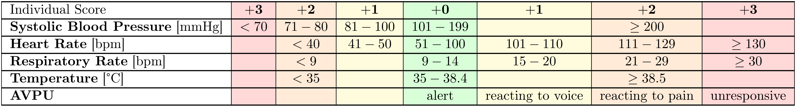
Background: Modified Early Warning Score (MEWS)
Julian Lobbes

Slide 7
Motivation: Remote Patient Monitoring
Automated and remote EWS monitoring saves lives
  Faster detection
  Less prone to human error
  Frees up resources
Possible through improvements in smart monitoring technology
Julian Lobbes

Slide 8
Title
Bullet
Julian Lobbes

Slide 9
Title
Bullet
Julian Lobbes

Slide 10
Title
Bullet
Julian Lobbes

